Slide 1
Writing and Research Are Inseparable:
Helping Instructors Integrate Research and Writing Instruction in Writing Across the Curriculum Course Planning
LOEX 2021
Matt Johnson, UCLA Library
Sylvia Page, UCLA Library
Laurel Westrup, UCLA Writing Programs
Notes:
Intro: how collaboration began, course planner intro (15 mins?)
Introduce ourselves + shout out Christine - All
WP - Laurel
Library context -S as WP liaison, M as TLFT lead
Remind people to change chat from Panelists to Panelists and Attendees

Slide 2
Learning Outcomes
Participants will be able to:
Employ new strategies for collaborative relationships with their writing faculty and other campus partners to have a direct impact on curriculum
Recognize the challenges encountered by writing across the curriculum faculty and TAs in their approach to making students aware of the links between writing and information literacy.
Identify train-the-trainer opportunities on their campus that raise awareness among teaching faculty of ways to help students integrate writing and research processes.
Notes:
Sylvia

Slide 3
Session Overview
Background & Context
Introducing the Course Planner
Using the Course Planner
Train-the-Trainer Approaches to Teaching Writing & Research Together
Next Steps & Future Projects
Notes:
Matt
Mention that we will have opportunities for conversation between each of the main sections

Slide 4
Background and Context
Writing and Research Integration Course Planner
Originally a Writing Integration Course Planner
Designed to aid instructors in incorporating and scaffolding writing and research skills throughout their courses
Notes:
Laurel

Slide 5
The Core Competencies
Research & Information Literacy at UCLA
Provide a programmatic view of expectations for teaching & evaluating research & information literacy skills
Presents practice-oriented competencies to complement the ACRL Framework’s threshold concepts
Developed with UCLA’s context in mind while also considering the need to adapt the competencies for different fields and experience levels
Notes:
Matt
Specifically, this project sought to scaffold the core competencies for Writing I and II courses in order to encourage programmatic adoption and use to help us develop students’ research and information literacy skills earlier in their careers at UCLA.
Core competencies - https://escholarship.org/uc/item/2t03q5bw

Slide 6
Adapting the Course Planner
Notes:
Sylvia
Course planner: https://docs.google.com/document/d/1pEgNXuJGgnE3z-xGhTmAlHxA0dmG2rdvD_INyu3wLBw/edit?usp=sharing

Slide 7

Poll Question: How are writing & information literacy integrated on your campus?
Notes:
Matt
Participate at http://pollev.com/mattweirick

Slide 8
Using the Course Planner
Notes:
Laurel
Course planner: https://docs.google.com/document/d/1pEgNXuJGgnE3z-xGhTmAlHxA0dmG2rdvD_INyu3wLBw/edit?usp=sharing

Slide 9
The course planner video
Our objectives in making the video:
“Flip” our course planner instruction so that we could use our 60 minutes of class time with graduate student instructors more actively
Condense and apply some of the best practices from the (admittedly very long) course planner document
Give graduate student instructors a real world scenario where they might use the resources in the course planner to help their students succeed
Inform viewers of best pedagogical practices for teaching writing and information literacy without coming across as pedantic

Slide 10
Walkthrough of Video
Notes:
***

Slide 11
Questions to Consider in Designing Writing Prompts
-- What are the intellectual demands of an assignment?
-- What are the writing demands of an assignment?
-- What are the research demands of an assignment?
Notes:
***

Slide 12
Problematic Essay Prompt
Choose a case of cultural appropriation. Write an essay that makes a compelling argument about your case in the context of cultural appropriation. Your essay should:
Have a clearly articulated thesis
Be 5-6 pages, typed, double-spaced, with one-inch margins and standard font (usually Times New Roman)
Draw explicitly on your research (and course readings as relevant) effectively and insightfully
Include your own detailed analysis of relevant examples (even if you are also discussing others’ interpretations/analysis)
Use proper MLA-style parenthetical citation with a Works Cited
Your essay will be due on Thursday of Week 9.
Notes:
***

Slide 13
Writing Questions Students Will Have about the Problematic Prompt
What criteria should be considered in order to conduct a successful case study? (how broad or specific should the case that I choose be?)
Should it be one of the cases covered in the class or one that I find outside of class?
If someone else has already written about this case, how do I avoid duplicating their conclusions or just copying their ideas?
Should my thesis be an argument about the case or about cultural appropriation with the case as evidence?
How am I supposed to analyze this case? Are there ideas about cultural appropriation that are part of the course that I should use to develop my argument?

Slide 14
Research Questions Students Will Have about the Problematic Prompt
To find a case not covered in class, where would I go to start looking? How would I look?
What kind of research will “count” as evidence? Where will I find it? How will I identify whether or not what I’ve found “counts” or is “relevant”?
How should I use the research that I find -- as a lens for understanding the case? or as context for understanding the case? or as support for an argument I might make?

Slide 15
Other Questions Students Will Have about the Problematic Prompt
What opportunities will students be given to get feedback on work in progress, and from whom?
What are the overall goals of the assignment (and by extension, what will the focus of assessment be)? What is my purpose in writing this assignment? How will I be graded?

Slide 16

More Instruction Needed
Notes:
***

Slide 17
Considering Purpose of Assignment
Students will:
develop their cultural competency surrounding the issue of cultural appropriation through an example of their choosing that matters to them and that hasn’t been covered in the class
apply course concepts about cultural appropriation to a novel case
build research skills (designing a research question; finding, evaluating, and synthesizing sources; organizing research materials)
effectively communicate their knowledge to an academic community
hone their writing process (brainstorming, drafting, giving and receiving feedback, revising)

Slide 18
Addressing a Research Pitfall
A possible student question about the prompt:
Should I use a case study from class or find my own case study? How would I go about finding my own case study and making sure that it’s appropriate for the prompt?
Notes:
***

Slide 19
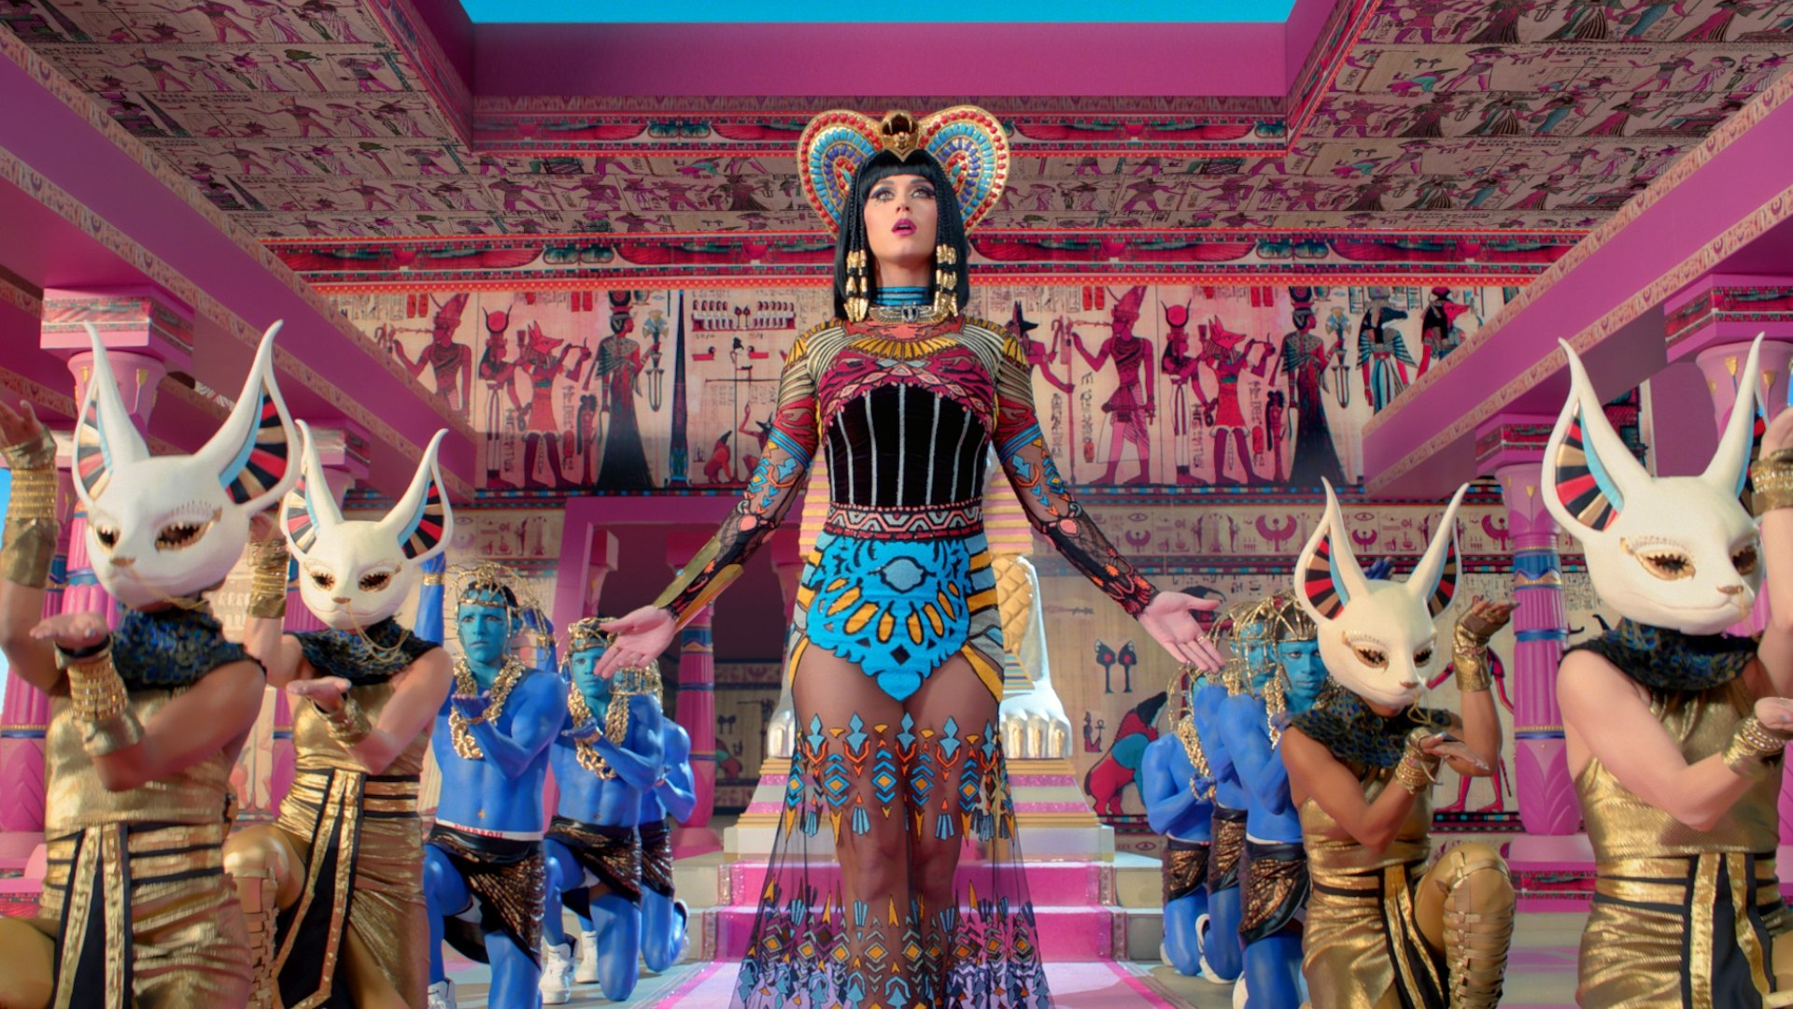
Adding Clarifying Language to the Prompt
Add details in the prompt about criteria for a successful case study or examples of successful case studies would be useful (for this prompt, one example might be Katy Perry’s “Dark Horse” music video)
Dedicate class time to discussing where to look for cases and to point out good or difficult examples could also help to clarify the expectations for students

Slide 20
Model the Process of Evaluating a Case Study for Relevance
Show students how to find an example
In class or in a recorded video, take a look at a few examples of case studies
Discuss or work with students to identify what makes a good case or a case that may be difficult for this assignment. In the process, you’re helping students develop evaluative criteria and may be able to help students figure out where to look for cases.

Slide 21

Start with Questions (Use A Premade Tutorial)
To give students a structured way to develop their research questions from their chosen case, consider incorporating a concept mapping activity

Slide 22
Addressing a Writing Pitfall
Two foundational questions students might have about the essay:
Should my thesis be an argument about the case OR about cultural appropriation with the case as evidence?
How am I supposed to analyze this case? Are there ideas about cultural appropriation that are part of the course that I should use to develop my argument?
Notes:
***

Slide 23

Instructional Strategies to Help Students Write to the Prompt

Slide 24
Modeling What a Published Case Study Looks Like
Assign a case study model that makes arguments about cultural appropriation. Ask the students to:
evaluate the effectiveness of the author’s argument
determine how well they use the case to provide evidence for their argument.
consider whether the author focuses their argument on the case itself OR whether they use the case to make a larger claim about cultural appropriation with the case as evidence?

Slide 25
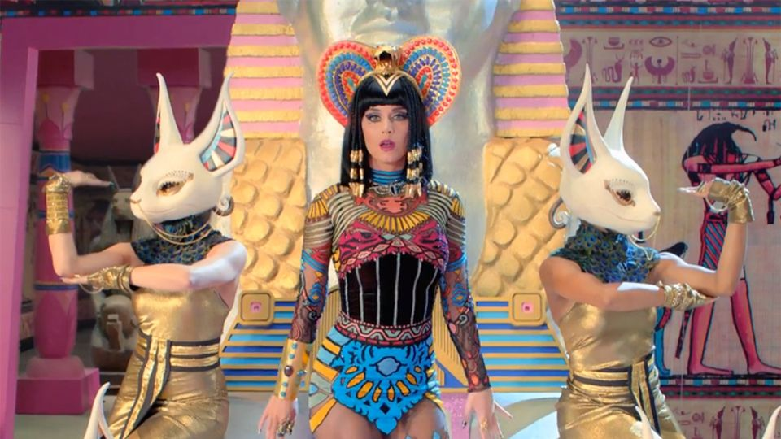
Modeling What Case
Analysis Looks Like
Focus on one case of cultural appropriation (e.g., Katy Perry’s “Dark Horse” music video) as a whole class.
Ask students to:
identify key details, such as lyrics, costuming, musical and dance elements, that relate to cultural appropriation
assess whether these details constitute cultural appropriation
evaluate each element, using course concepts

Slide 26
Experimenting with Thesis Statements
Before class, ask students to develop 2 thesis statements for their case analysis and post them to the discussion board:
Thesis Version #1 -- Write a thesis that makes an argument about the case itself
Thesis Version #2 -- Write a thesis that uses the case to make a claim about cultural appropriation
In-class in groups, students workshop the 2 versions of each student’s thesis statement with peers asking questions about each thesis to help the writer develop their ideas further.

Slide 27

Taking the Case Study
for a Test Drive:
Student Presentations

Slide 28
Writing Instruction Beyond Thesis & Analysis -- “Staging the Writing Process”
Thesis statement → Outline
“Shitty” first draft (see Anne Lamott’s “Shitty First Drafts”), “zero” draft, or “down” draft (just get it down)
Complete rough draft
Revised draft

Slide 29
Writing Instruction Beyond Thesis & Analysis -- In Class Workshops
writing a strong introduction
citing sources appropriately
organizing ideas for flow
editing for sentence-level grammar and style

Slide 30
Challenges
Notes:
Sylvia: challenges of the video (length, difficult to navigate, etc.)

Slide 31
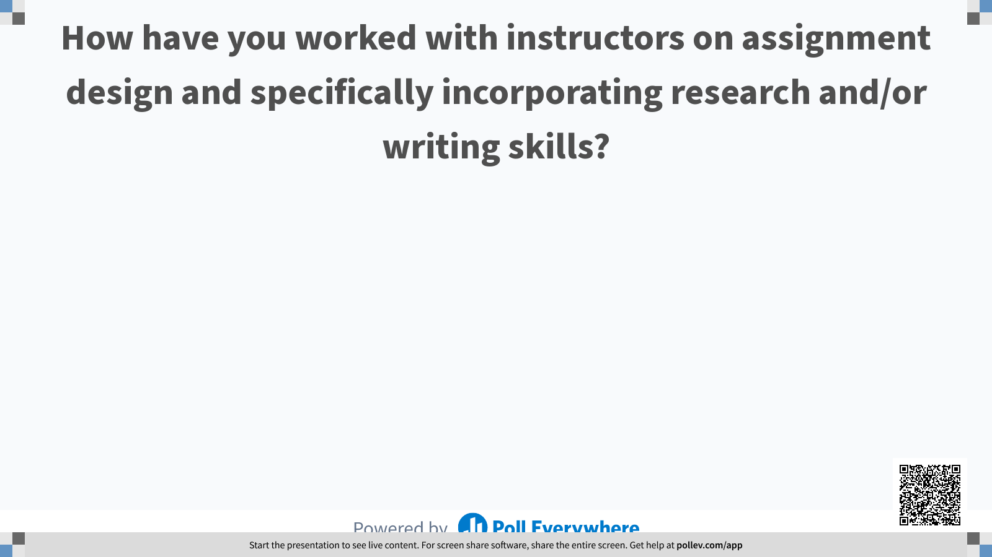
Poll Question: How have you worked with instructors on assignment design and specifically incorporating research and/or writing skills?
Notes:
Sylvia
Participate at http://pollev.com/mattweirick

Slide 32
Teaching TAs to Integrate Writing & Research Skills
Notes:
Sylvia

Slide 33
Collegium of University Teaching Fellows (CUTF)
Preparation Seminar
Notes:
Laurel

Slide 34
ENGCOMP 495E
Teaching Preparation Seminar: Writing in the Disciplines
Notes:
Matt
We started working with ENGCOMP 495E in Fall 2020 and have continued providing a one-shot, hour-long workshop each quarter since then working with many students preparing to teaching Writing II disciplinary writing courses. We talk with students about scaffolding research instruction, research pitfalls, and anticipating student questions about our assignments. One of the challenges of the course is that some of the TAs will be teaching classes that they design themselves with assignments they design, but other TAs will be working with faculty, teaching sections of courses, where they don’t have control over the syllabus or assignments. It can be a challenge to teach effectively to both groups and to consider what options everyone has for scaffolding the research and writing instruction in their classes.

Slide 35

Poll Question: What are the train-the-trainer opportunities on your campus?
Notes:
Laurel
Participate at http://pollev.com/mattweirick

Slide 36
Next Steps & Future Projects
Notes:
Matt

Slide 37
Some Ideas
Continue work on scaffolding the Core Competencies
More collaboration with Writing II at UCLA
Proposing a 495R TA training course
Changes to how we present this work
Notes:
Next Steps (5 mins)
Scaffolding core competencies -M
More collaboration with Writing II
Instruction training for students
More targeted instruction for Writing II
Possible 495R -M
Changes to how we present this work -L
Moving to Canvas
New, more interactive format
Redo the video--making shorter videos for new interactive format

